Slide 1

GIS for Geoscientists Session 1
Image Credit: Patrick Kennelly, Montana Bureau of Mines and Geology
Presented by Nicholas Barber, 4th Year PhD Student at the University of Cambridge, U.K.
ndb38@cam.ac.uk | www.volcannick.com | https://github.com/ndb38 | Twitter @volcannick

Slide 2





Acknowledgements
Thank you to McGill University (Cat Crotty), University College London (Emma Liu), and the Volcano Magmatic Studies Group (Claire Harnett and Emma Watts) for helping to shape the course, and for providing a platform where I can share my love of GIS with you!

Slide 3
Course Outline
Wed. Nov. 3rd: Session 1 – Principles for using GIS in the Geosciences
Course Objectives
Principles of GIS
Tour of the Interface
Wed. Nov. 10th: Session 2 – Beginner GIS Exercises
Guagua Pichincha Hazard Assessment
Projections + Data Types
Managing Layers, Manipulating Data, Designing Your Map
Wed. Nov 17th: Session 3 – Intermediate GIS Exercises
Getting more out of GIS
Geoprocessing, Spatial Analysis, Data Management, Advanced formatting, Geostatistics
Wed. Nov. 24th: Advanced GIS Exercises
Peak into Advanced GIS
Custom Actions , Model Builder, Python, Google Earth Engine, Databases

Slide 4
Couse Resources
You should have access to all course material through my GitHub under the “VMSG’ folder. All relevant readings, and supplementary material will be posted there.
Recordings will be made available through the VMSG YouTube page:
https://github.com/ndb38/gis-for-geoscientists

Slide 5
Post-Lecture Feedback
After this lecture, please follow this link to provide me with some feedback on my teaching style: https://forms.gle/JMy7qB3E6Qcfvhjm9
My goal is to consistently improve this course. Your feedback allows me to improve this course for future students

Slide 6
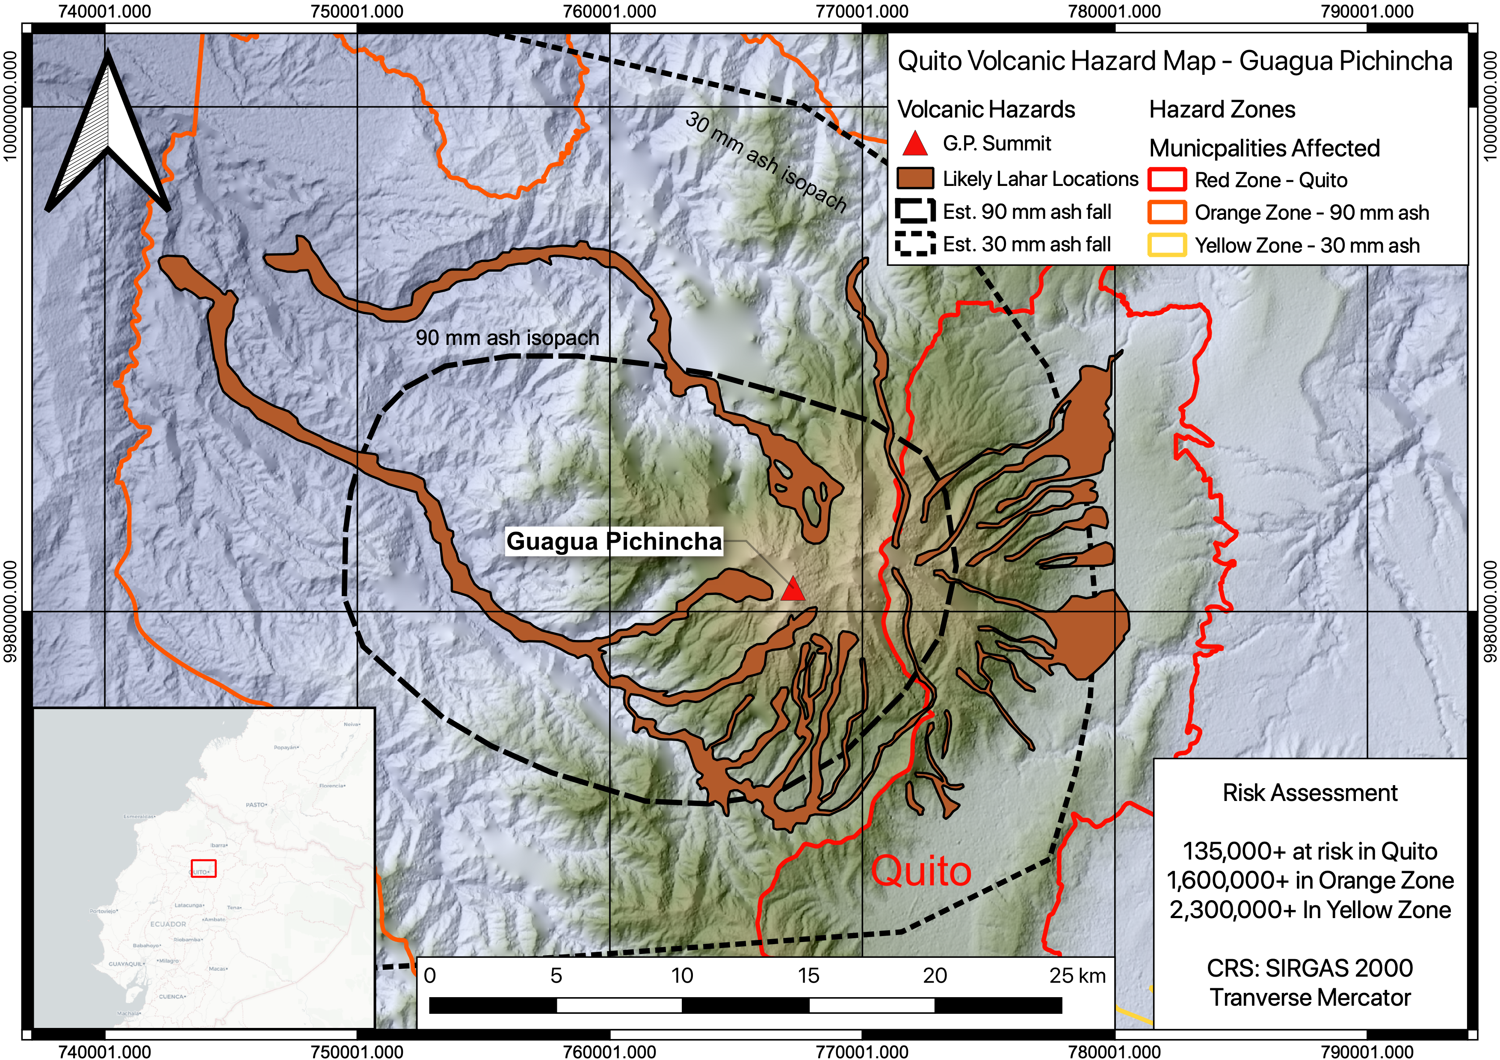

Slide 7
You will be able to make this map!

Slide 8
Outline of Today’s Session
Objectives (10 Minutes)
My Background (10 Minutes)
Principles of GIS (30 Minutes)
Whirlwind Intro to QGIS
(30 Minutes)
Break + Q&A (20 Minutes)

Slide 9
Objectives
GIS = Geographic Information System
Definition:
“A GIS is a computer-based system to aid
in the collection, maintenance, storage,
analysis, output, and distribution of spatial
data and information.” – Paul Bolstad (GIS Fundamentals)

Slide 10
Questions you may have going into this course:
What is GIS?
What can it do for me and my studies? My future career?
What’s the best GIS software?
How do I learn the ins and outs?
Topics raised from past attendees:
What do I need to know about GIS for my job?
Which coordinate system is preferred?
How do I georeference a geological map?
How do I create a map of my field site?
Best practices for setting up a new project?
How do I automate QGIS tasks
with python scripts?
How do I connect to and query a cloud-based spatial database?

Slide 11
My goals over the next two weeks
Highlight what GIS can do for geoscientists
Outline the key principles of a geographic information system
Providing a fully guided GIS workflow template
Identify key areas of growth for GIS in geoscience research

Slide 12
If you take nothing else away from this course….
GIS is a helpful tool in your workflow if you have data with a spatial dimension
GIS software lets you store, collect, analyze, and share spatial data
Modern GIS platforms like ArcMap and QGIS are all around workhorses – essential to tasks like spatial modeling, database management, cartography, geodesy, data visualization, hazard mitigation, and story telling
Learning the capabilities of GIS is acquired from repeated, trial and error with the hundreds of built-in tools
Studies should be designed with the GIS end user in mind!!!

Slide 13
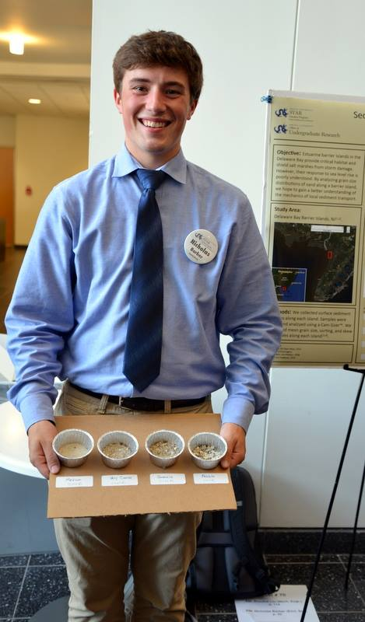
My Background
Past: B.S. Geoscience (Honors), Drexel University, USA
Current: PhD Earth Science, Cambridge, UK
Specialty Areas: Volcanology, Igneous Geochemistry
GIS Experience:
August 2014 - Present

Slide 14
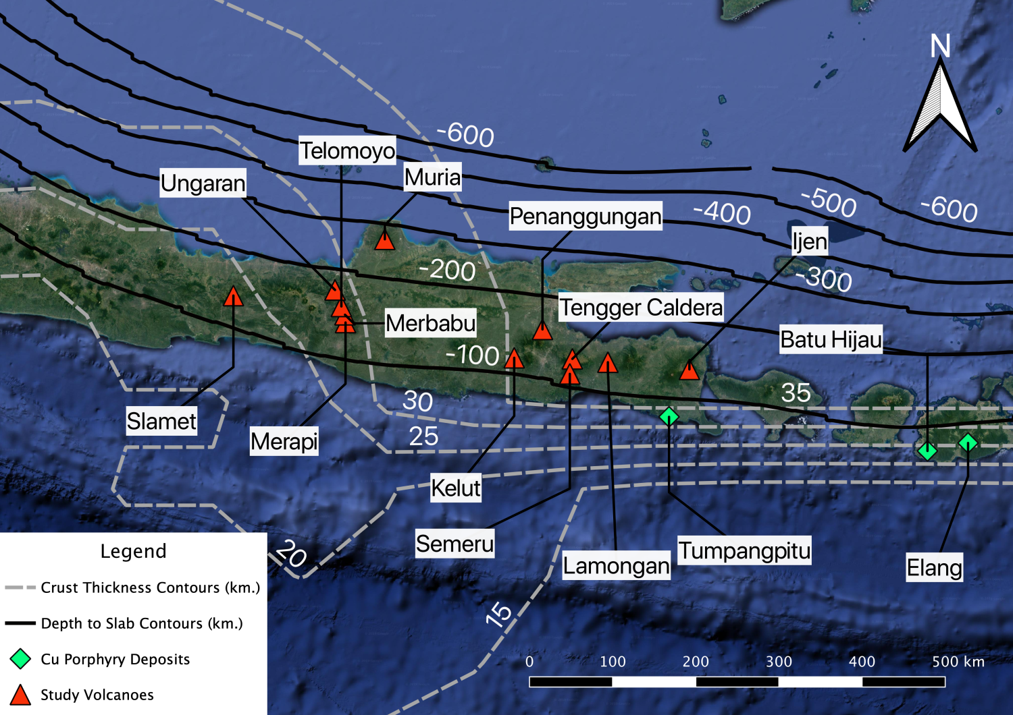
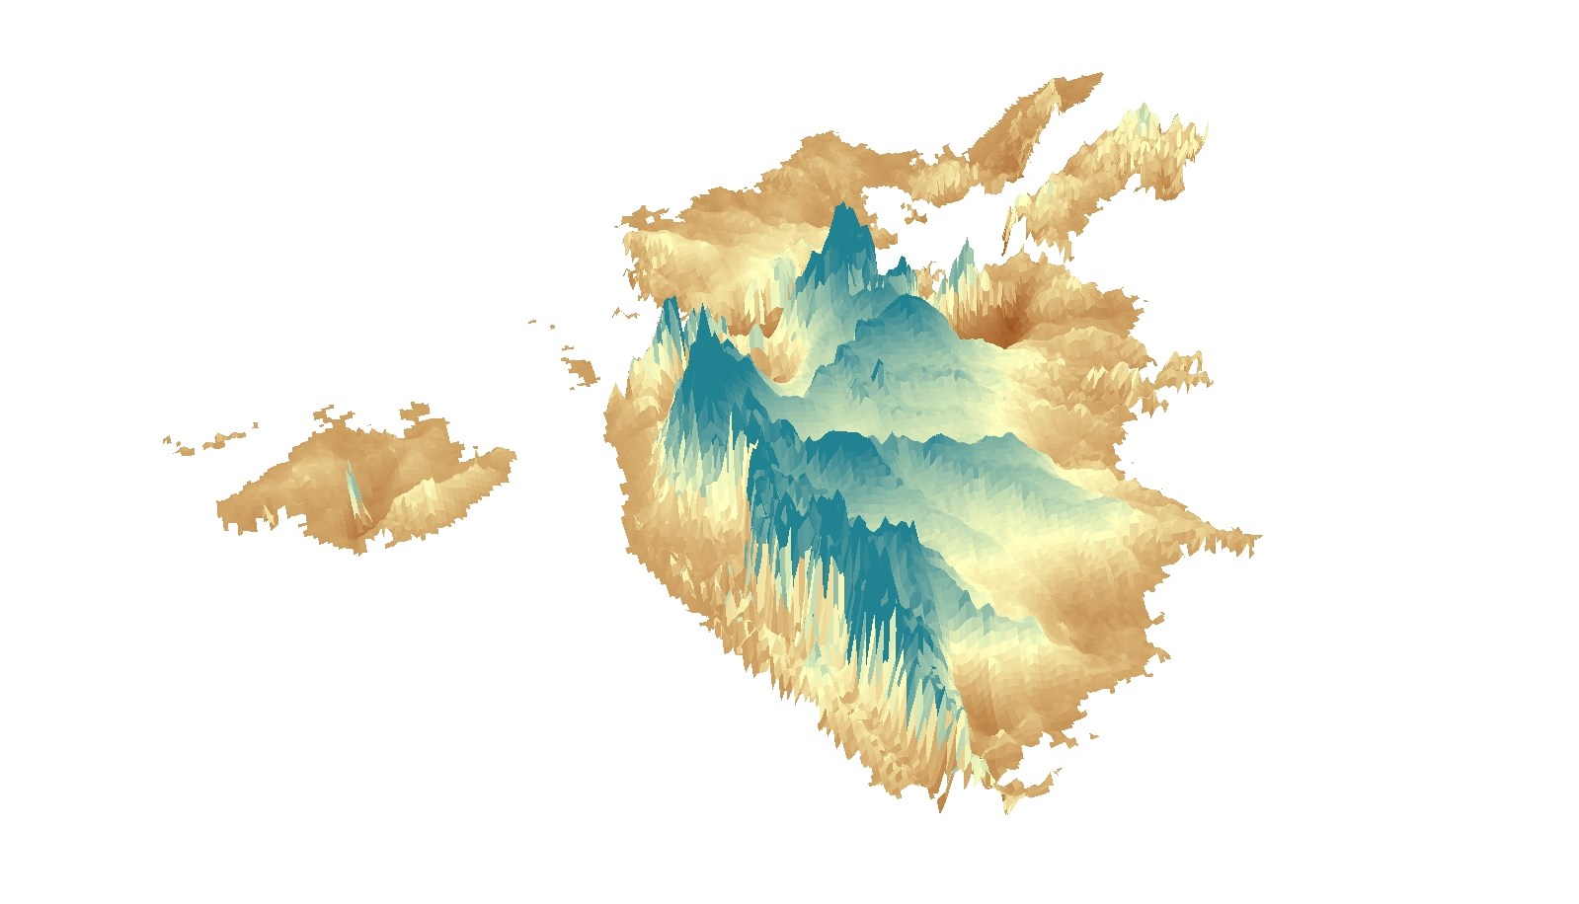
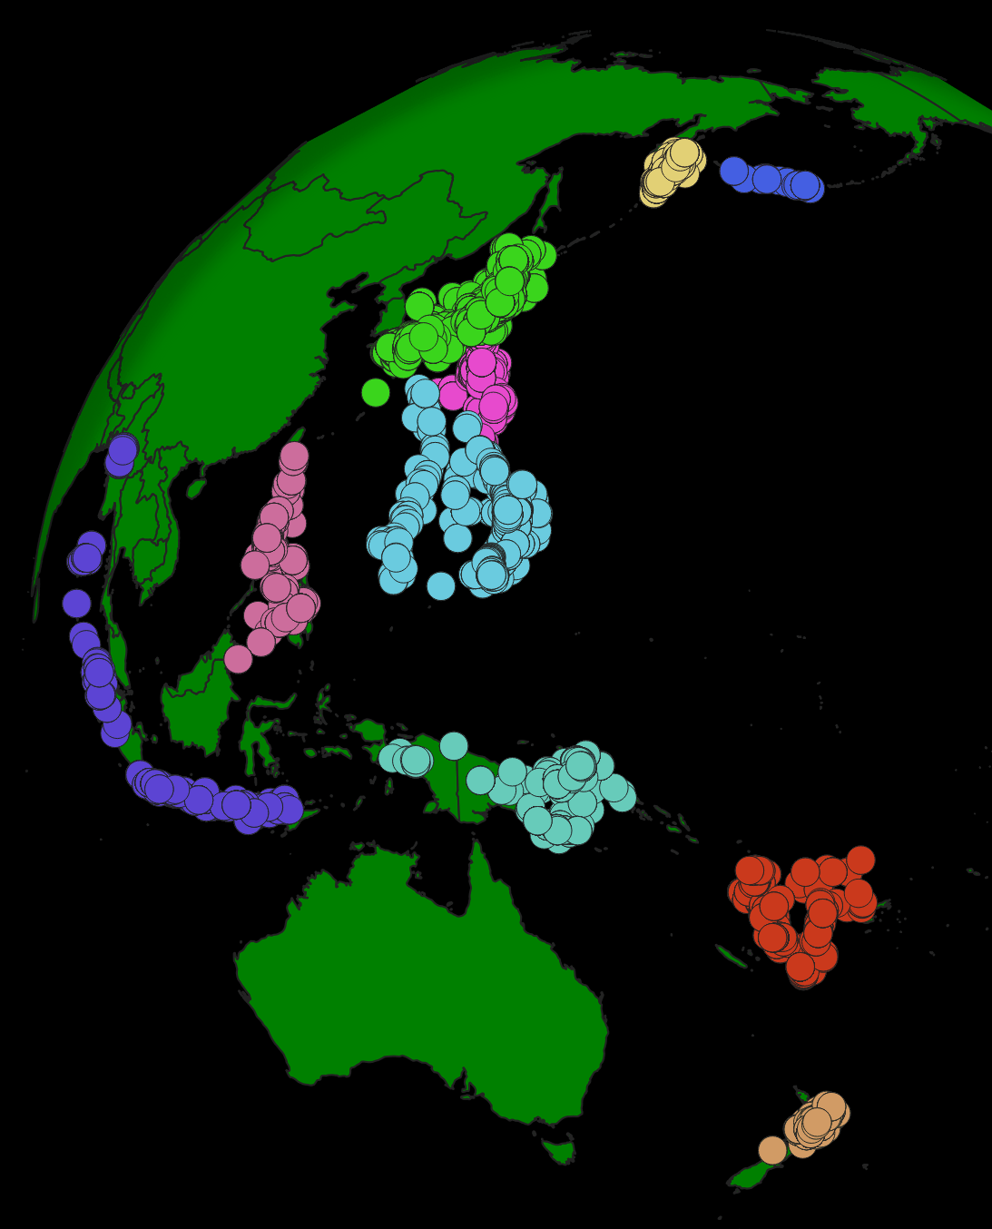
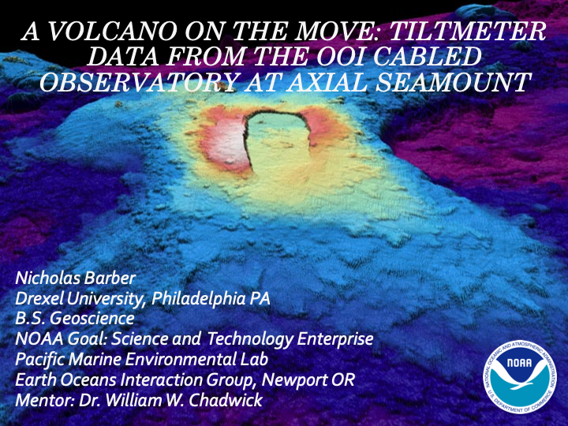
(Above) September 2018 to Present: Metals in Magmas Field Campaign, Java, Indonesia
(Below + Right) January 2016 to Present: Senior Project - Volume of Deccan Traps
(Right) August 2019 to 2021): ArcMetals Global Arc Chemistry Database. Published in GCA! 10.1016/j.gca.2021.05.034
(Right) May 2017 to August 2017: Deformation modeling with NOAA; Seafloor volcano Axial Seamount

Slide 15
Principles of GIS
Working Principles → Data Management → Projections → Data Types → Errors → Layout → Software

Slide 16
Data Management
GIS data is diffuse, found in about 1000 different repositories
Governmental
Nonprofit
Educational
Research
Individual papers
Consortiums
Private
File structure complex – one elevation dataset may have 6+ individual files, that all get compiled upon use in software
File size can be massive: my master elevation dataset for Western India is several gigabytes!
In a GIS software, proliferation of “layers” mandates good naming schemes, efficient data storage, and logical file structure

Slide 17
“Rules of GIS” Rule #1: Pick a naming scheme, file structure, data format that suits you. Keep it consistent and document every choice you make throughout a project!

Slide 18
Coordinates & Projections
We use coordinates to define the “where” on a map
Easting and Northing
X and Y
Latitude and Longitude
However, defining where something is may not always be straightforward
Maps are a flat surface, and the earth is 3D. There is inherently distortion converting coordinates from 3D to 2D
Need to consider that the Earth is not a sphere
Error in spatial measurements
Physical location of an object changes through time

Slide 19
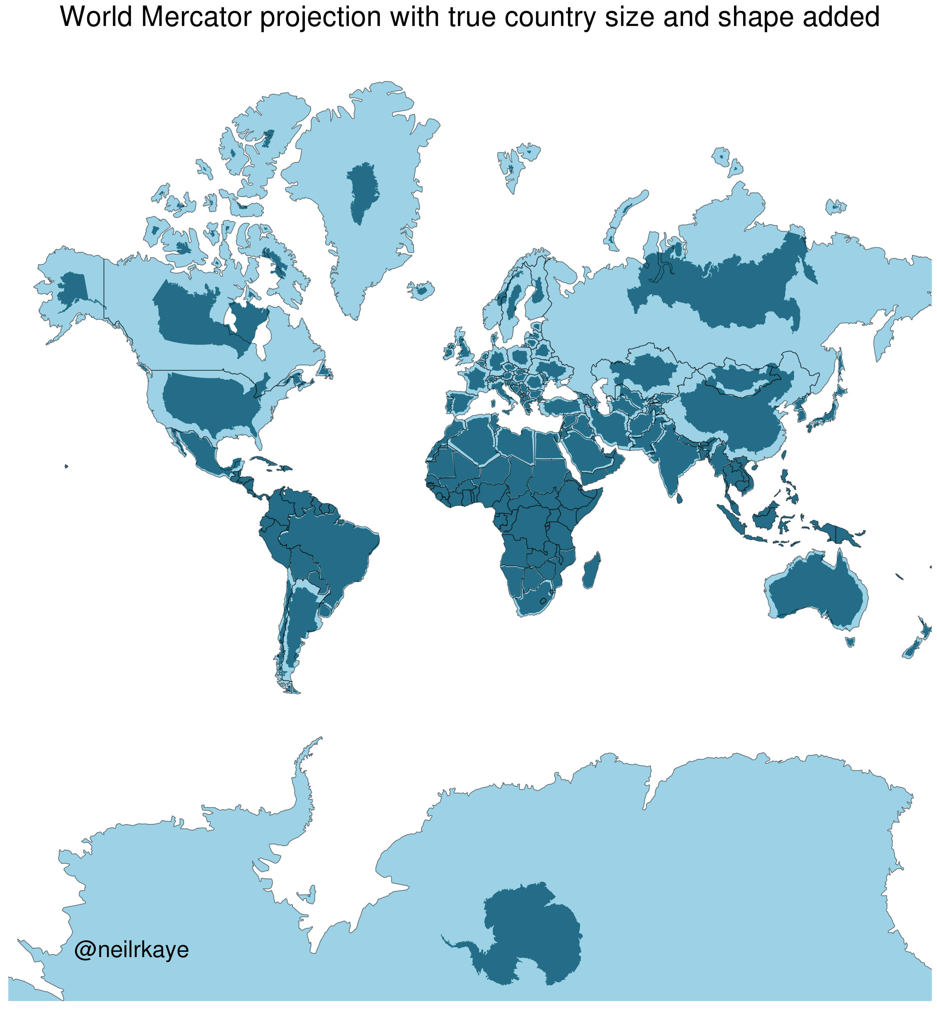

Slide 20
Rule #2 : Known your coordinate system and make every layer in a project use the same system. This needs to be done prior to any analysis!!

Slide 21
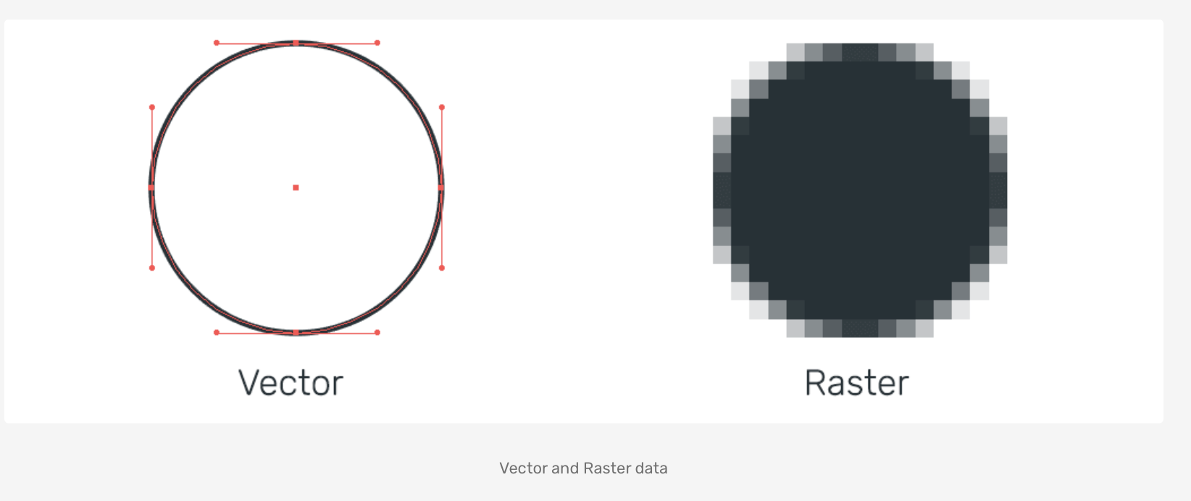
Data Types
VECTOR DATA
Essentially, a spreadsheet that is visualized by a geometry
Geometries include Point, Line, Polygon, Multiline, Multishape, etc.
Common format: Shapefile (.shp), Geopackage (.gpkg), File Geodatabase, KML, Common uses: Showing boundaries, locations
Relevant data stored in a separate table
Drawbacks: Complex file structure
RASTER DATA
Digital image, with data stored in discrete cells of a specific resolution & spectral value
Efficient way to store and present large amount of data
Common formats: GeoTIFF, ESRI Grid, GDAL VRT, etc.
Common uses: Elevation, satellite data
Drawbacks: large file sizes, knowing how to visualize

Slide 22
Rule #3 : Design a project with these data types (and their limitations) in mind!

Slide 23
Errors
Sources of error abound in a GIS:
Accuracy of datum and projection system
Positional accuracy of data
Map Scale accuracy
Tied to original scale at which data was mapped, not the scale at which you do the analyses
Quantitative accuracy of attribute data
Conceptual accuracy
How accurate it is it to cluster features into different groups?
Knowledge of User
“Human Error”
For example: estimated error introduced by manually tracing geological boundary in a GIS

Slide 24
Rule #4 : Enumerate error sources at the start of a project, and document error + error propagation as you go!

Slide 25
Layout + Design
Aesthetic choices when presenting your work are scientific decisions. Also a form of data!
Color scheme
Scales
What you chose to show vs. what you didn’t
How much detail do you give your reader?
What kind of message are you sending your audience?

Slide 26

11/3/21
“Not only is it easy to lie with maps, it’s essential. To portray meaningful relationships for a complex, three-dimensional world on a flat sheet of paper or a screen, a map must distort reality.” – M. Monmonier
Need to ask yourself: How am I distorting reality when making this map?
25

Slide 27
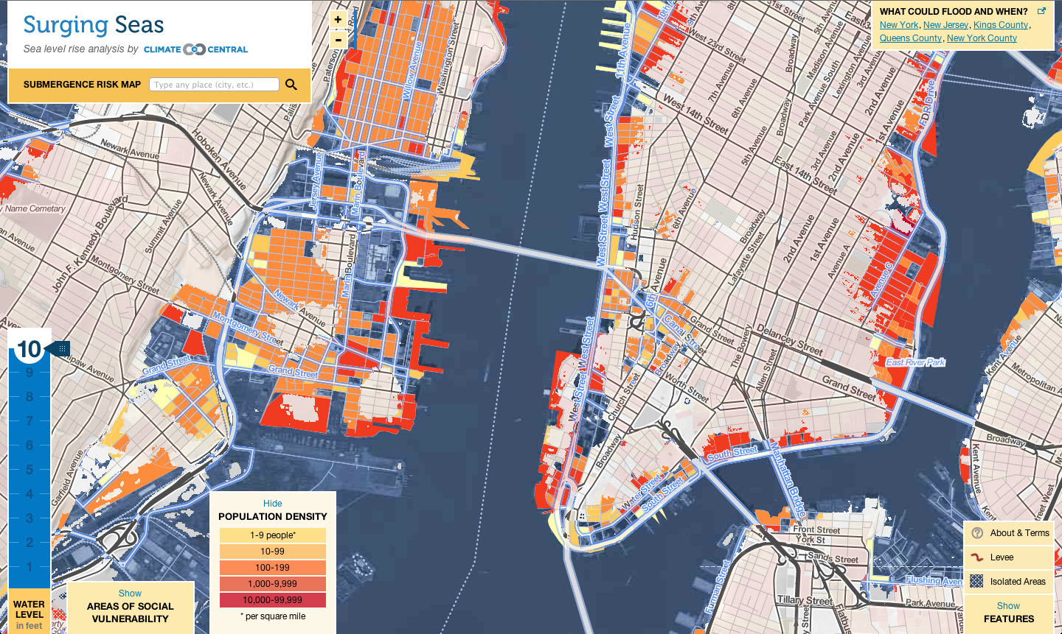
Essential, and one of the most challenging/impenetrable aspects of GIS
Based on principles of design + cartography. Need visualization to be as elegant as it is accurate
Remember data reusability! Underlying data accessible and well documented

Slide 28
Rule #5 : Design is as important as the data– treat any GIS output as you would any figure in a paper!

Slide 29


Software: The Two Juggernauts
ESRI’s ArcMap
Quantum GIS (QGIS)
Proprietary & Industry Standard
The Gold Standard
Comes with a range of products, like Story Maps, ArcGIS Online, Customer support, 3D Viz, other Advanced tools
Data formats are often proprietary and closed-source
Algorithms + data structure can be opaque and hard to reference
Open source, community driven
Not as feature rich but a fast-rising competitor to Arc
Integrated with other open source projects like SAGA, GDAL, Python, PostGreSQL, GRASS GIS, etc.
Can read/process almost any data type
Interface can be clunky
Software dependency issues

Slide 30
Software: The Two Juggernauts
ESRI’s ArcMap
Quantum GIS (QGIS)
Proprietary & Industry Standard
In use for Decades
Comes with a range of products, like Story Maps, ArcGIS Online, Customer support, 3D Viz, other Advanced tools
Data formats are often proprietary and closed-source
Algorithms + data structure can be opaque and hard to reference
When not academically affiliated costs $$
Open source, community driven
Not as feature rich but a fast-rising competitor to Arc
Integrated with other open source projects like SAGA, GDAL, Python, PostGreSQL, GRASS GIS, etc.
Can read/process almost any data type
Interface can be clunky
Software dependency issues
VMSG GIS for Geoscientists- Session 1 - GIS Fundamentals Presented by N.D. Barber (Cambridge) ndb38@cam.ac.uk

Slide 31
Rule #6 : Keep in mind the audiences and limitations of each software. Make your software choice early, and stick with it!

Slide 32
Q&A

Slide 33
Introducing QGIS 3.16*
A fly-by-tour of the premiere open-source GIS software – QGIS

Slide 34
Overview of QGIS 3.16*
Installation
Opening up for the first time
Introduce layout
Browser
Layers
Various menus
Processing
Plugins
Layout
Project Settings
Properties
Symbology

Slide 35
On to the real thing!

Slide 36
For Next Time…
Make sure QGIS in installed or accessible on a computer you have access to
If you have any problems, contact IT people at your university/organization
Read Session 2 guide (forthcoming)
Watch any supplemental videos posted
Import the data off the GitHub (found under ‘qgis’ folder).
You can find instructions on the basics of QGIS in the guide
OPTIONAL: Complete the Lecture 1 Feedback form – to be sent out via email

